Slide 1
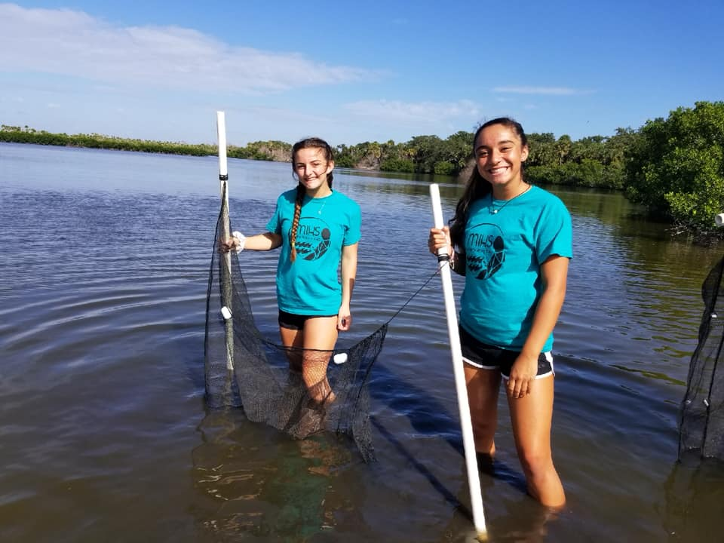

A Day in the Life of the Indian River Lagoon
Quick & Easy Tips for a
Successful ADIL Experience!

Slide 2
ADIL Preparation
1. Communication is KEY!
  Teachers and partners need to be in touch with each other in order to have clear expectations of the day. Don’t wait to communicate!
2. Quality vs. Quantity
  Take it slow; less is more. Doing a few things well is more rewarding than doing many things chaotically. Water chemistry and biological inventories should be prioritized.
3. In-class preparation makes a WORLD of difference
  Preparing students with the materials and activities –beforehand- will create a more effective & meaningful outcome. Trust me ☺

Slide 3
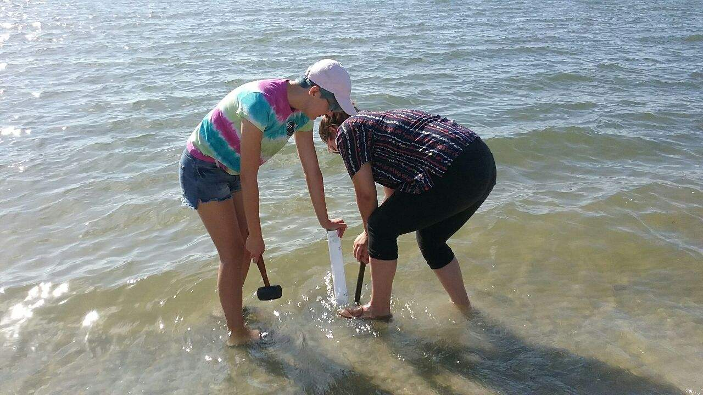
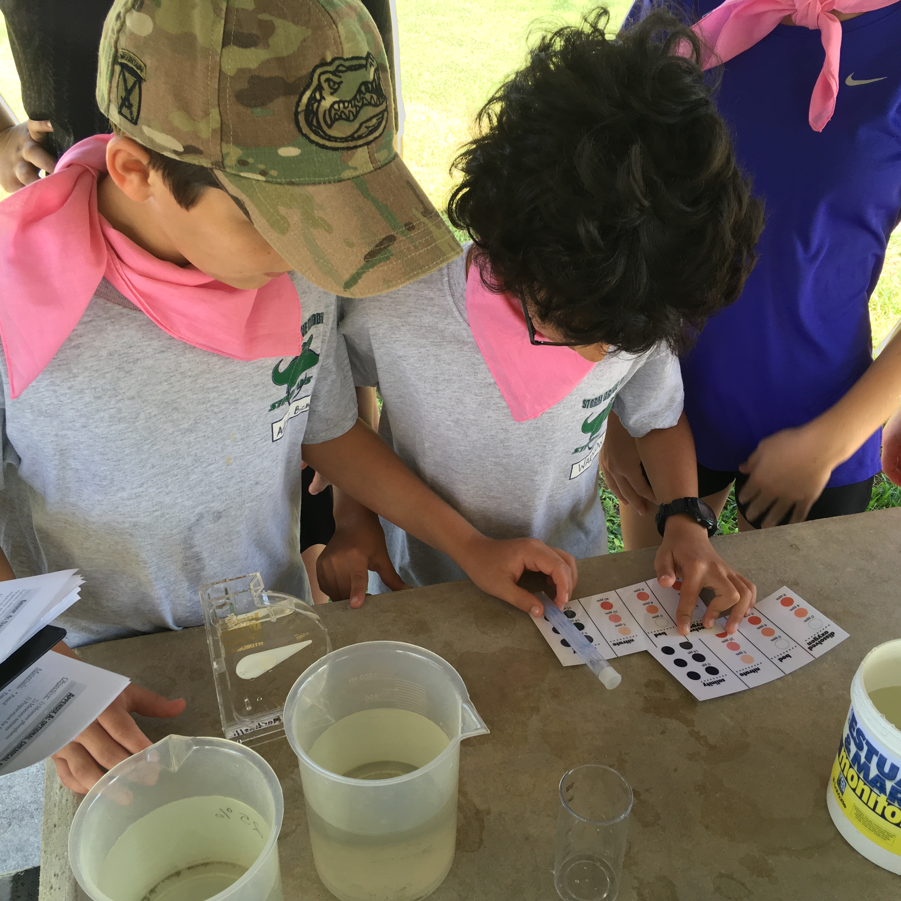
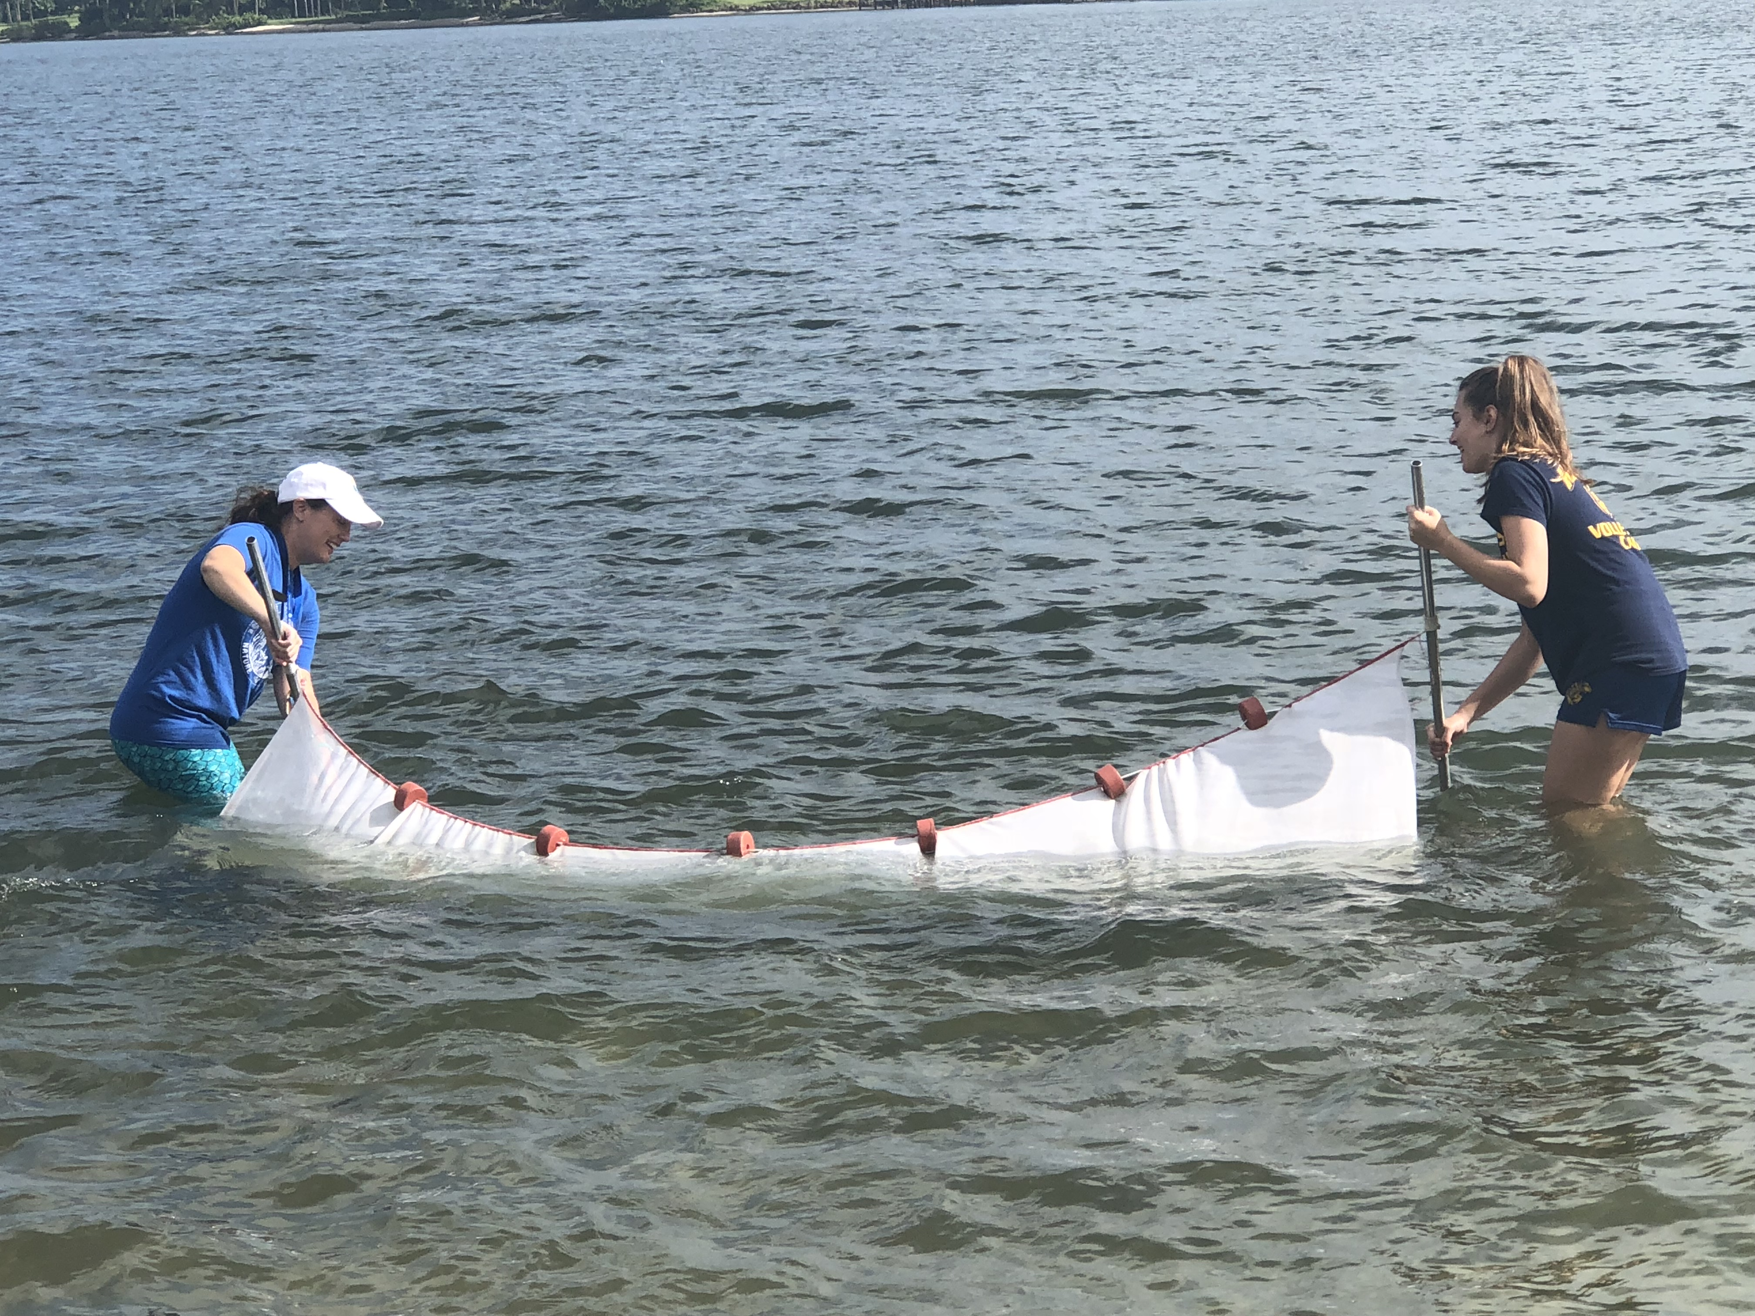
ADIL Preparation
4. Visit your site beforehand
  Familiarity with your site is a must in order to have a seamless ADIL experience. Make sure you allocate permission, if applicable.
5. Back-up activities
  Some stations or equipment may take longer than others. Group 4 is the longest. Familiarize yourself with each test.
  Instead of having all students gathered around one instrument, keep them occupied with other activities (i.e. site descriptions and sketches, physical conditions, silent journaling, etc.)
6. Transportation needs & permission forms
  Schools are responsible for transportation whether district or charter busses

Slide 4
Know Your Wait Times for
Water Quality
Nitrate has a 5 minute wait time
Phosphate has a 5 minute wait time
pH has short wait time
Dissolved oxygen has about a 9 minute wait time
Fecal coliform bacteria requires 24 hours
*Stagger your tests - Idleness is the root of mischief. Keep your students engaged and active by staggering your test.
  *Bring an extra bottle for waste products

Slide 5
Salinity
Salinity is a critical measurement
2. Know your equipment
  Hydrometers & refractometers measure salinity in different ways. Hydrometers measure salinity based on density while refractometers measure the light refraction relative to salinity of the sample
3. Hydrometers and refractometers measure in parts per thousand (PPT).
  If you use different instrumentation, please record that on your data sheet and be sure to include units!
4. Read your hydrometer off of a flat surface
5. Take your refractometer to a sunny spot
  You need a light source to appropriately record salinity. Step out from under that tent or shady tree!

Slide 6
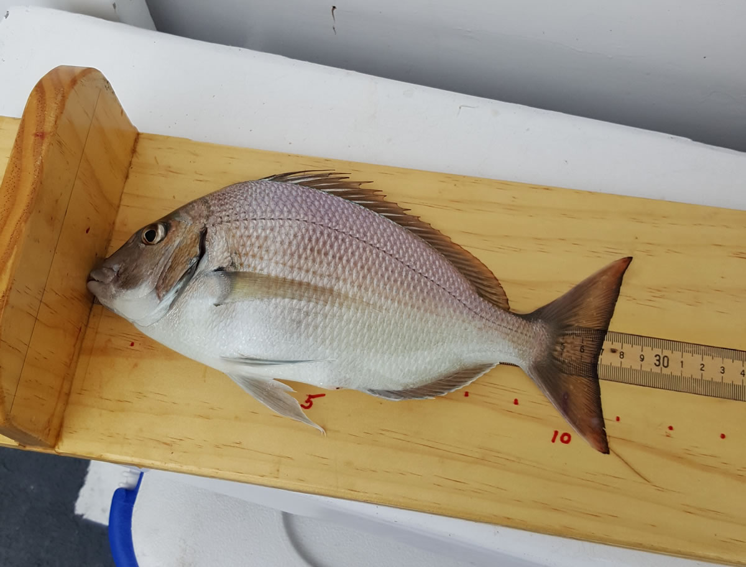
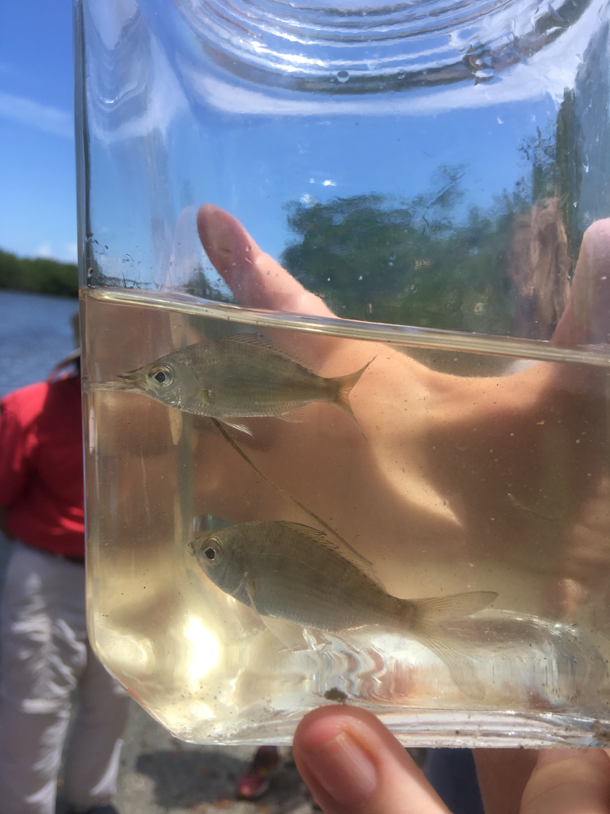
Biological Inventories
Fish Identification
1. Take pictures of your specimens
  Fish ID is challenging and can sometimes take a village of scientists to properly determine the specimen. We want to be certain that we have the most accurate data, so take photos of each organisms and send them to us.
2. How to photograph my fish?
  Hold the fish so that its head is facing the left, all fins are visible, and include a ruler or coin in the picture for scale.
Double check your identification
  In addition to reference guides, iNaturalist is an app that can assist with identification of organisms. Give it a try!

Slide 7
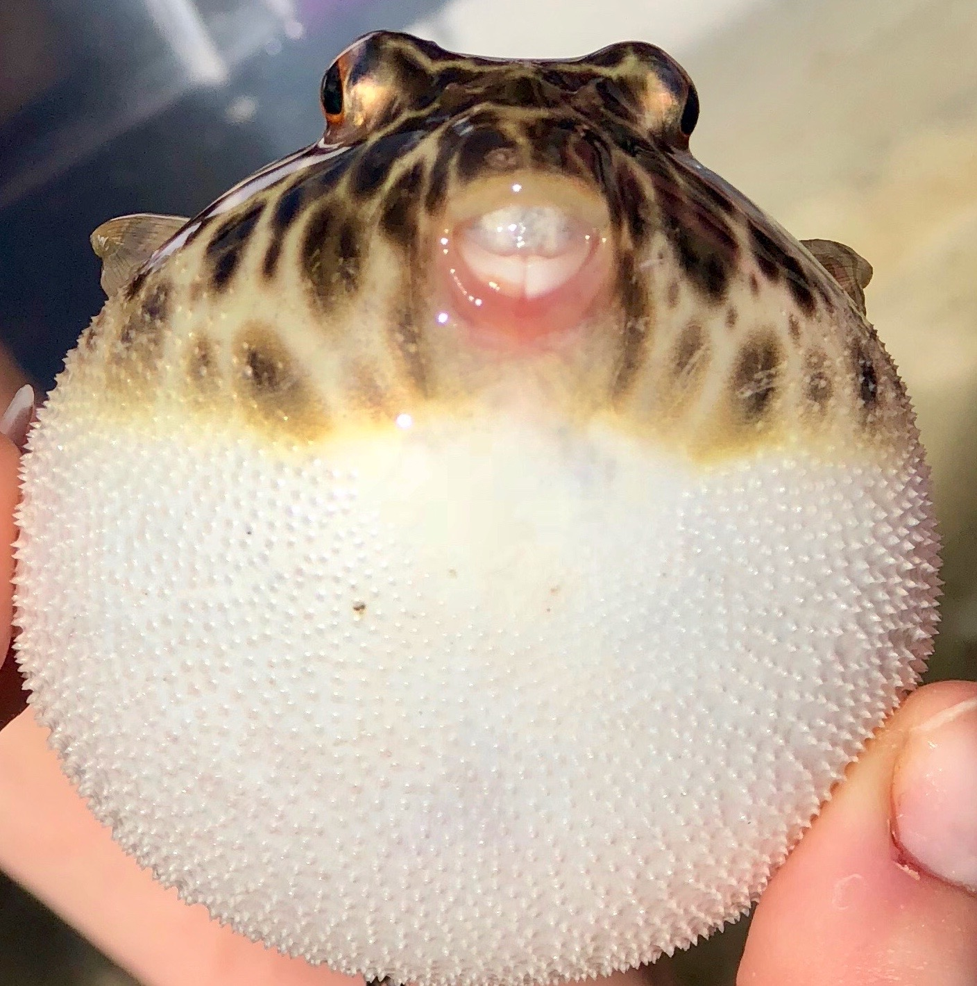
Biological Inventories
4. When in doubt, send pictures or ask questions
  We are more than happy to assist you in identifying your specimen. Send us an email (mweiss@teamorca.org) or text (Missy: 631-806-8725)
FMSEA/FWC Aquatic Species Collection Permit
- Someone on your team needs to have a current permit.
- For more information, click here

Slide 8
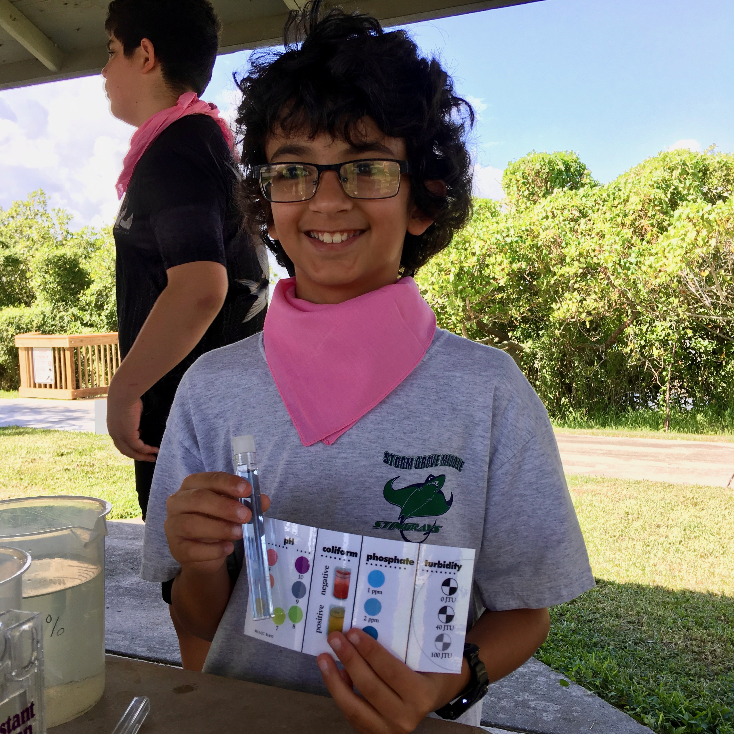
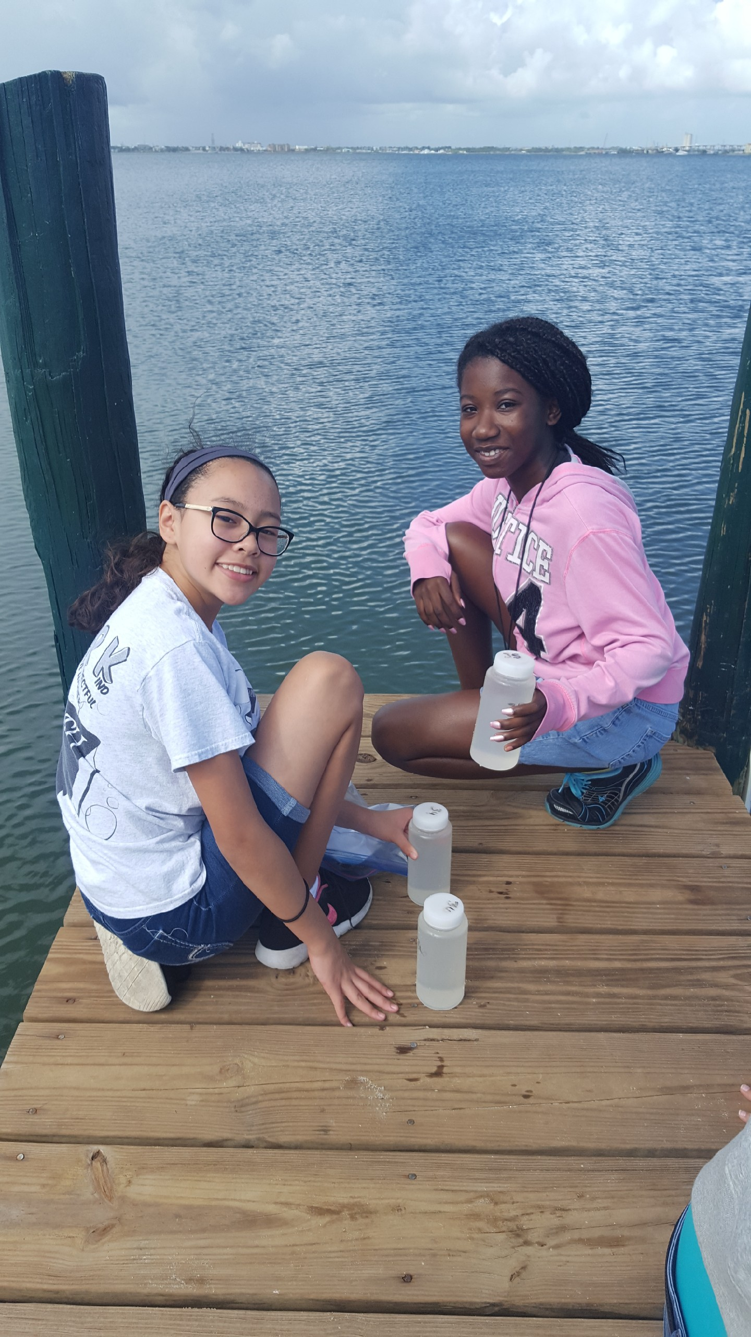
Data
1. Please send us your data
  Your data is contributing towards a long term dataset to further understand the IRL. You and your students’ data are a crucial component. This year, you will submit the data via an easy online form found on ORCA’s website and the entire packet via email. Remember to submit it on time!
2. Don’t forget the UNITS!
  Numbers don’t mean much without the units.
Notes:
Link the online form

Slide 9
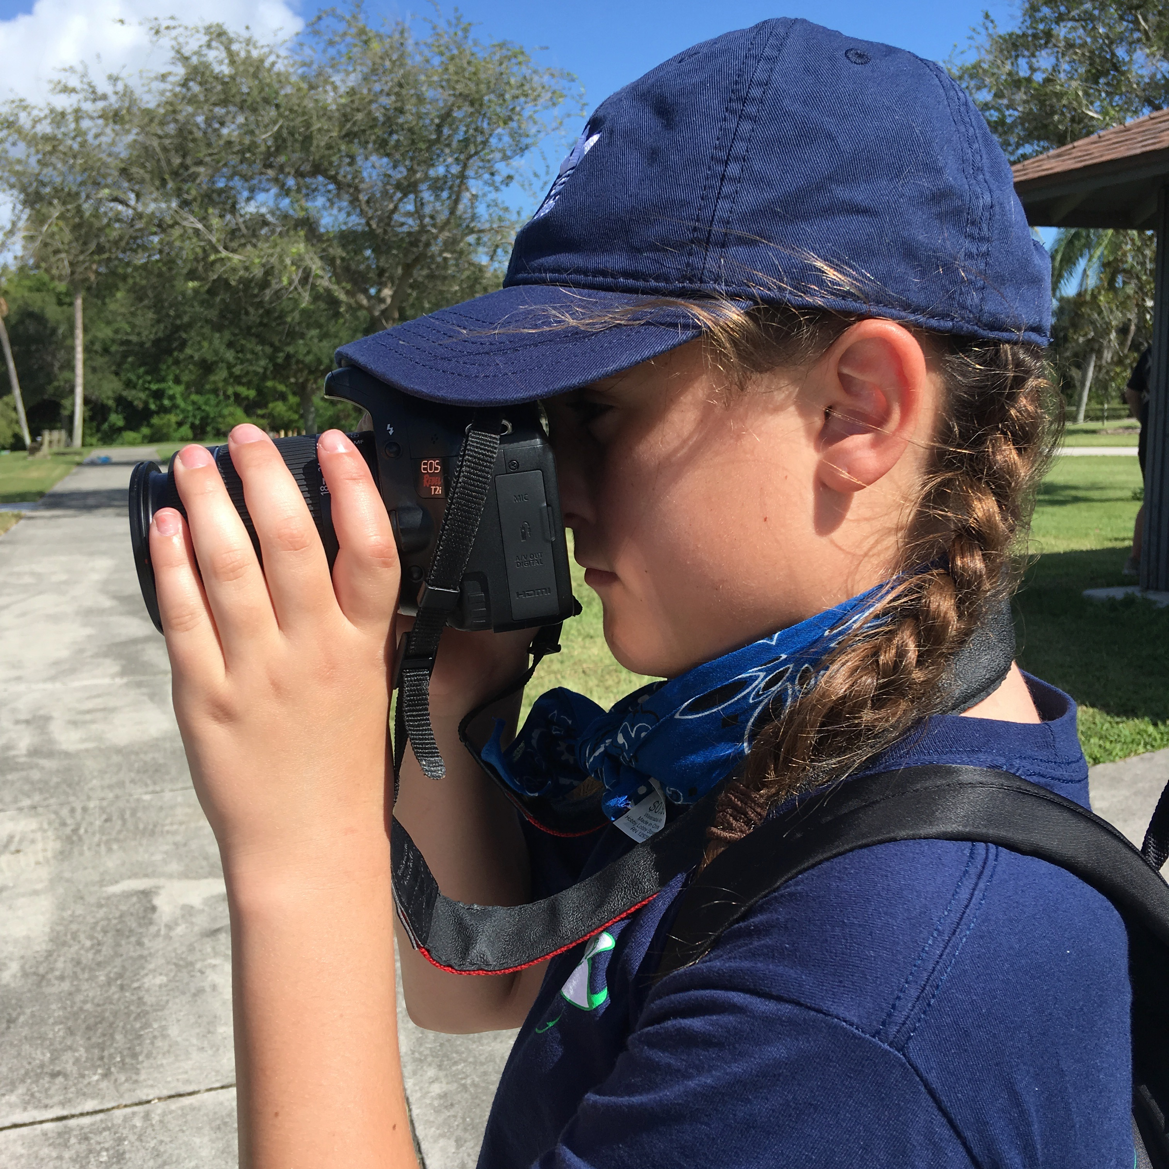
Photos & Photo Consent
1. Please take pictures of the day!
  The photos that you share with us bring citizen science and ADIL to life!
2. Photo consents
  While some schools have their own photo consent forms, they often do not include the use of pictures by other organizations. In order to highlight a student’s reaction to holding a fish for the first time or smelling sulfur in a sediment grab, we need to be sure ORCA is provided permission to be able to use pictures. Photo consent forms are available.

Slide 10
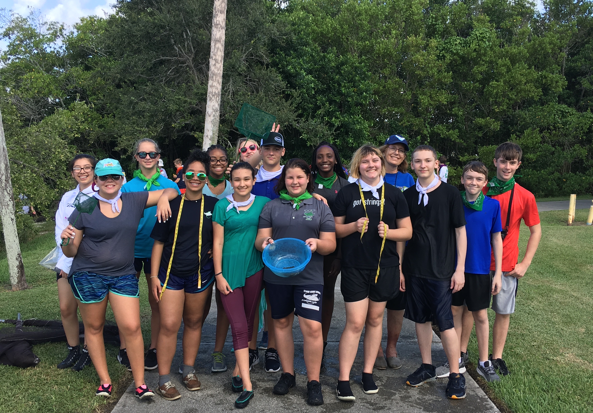
Most importantly…
HAVE FUN!!!

